Slide 1
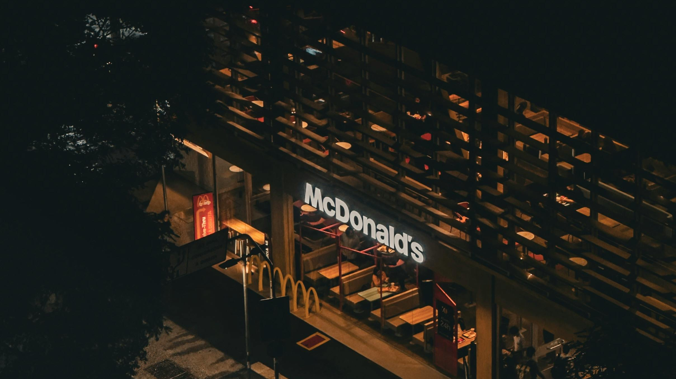
Mc Donald’s

Slide 2
Mc Donald’s
McDonald's Corporation is an American multinational fast-food chain, founded in 1940 as a restaurant operated by Richard and Maurice McDonald, in San Bernardino, California, United States.

Slide 3
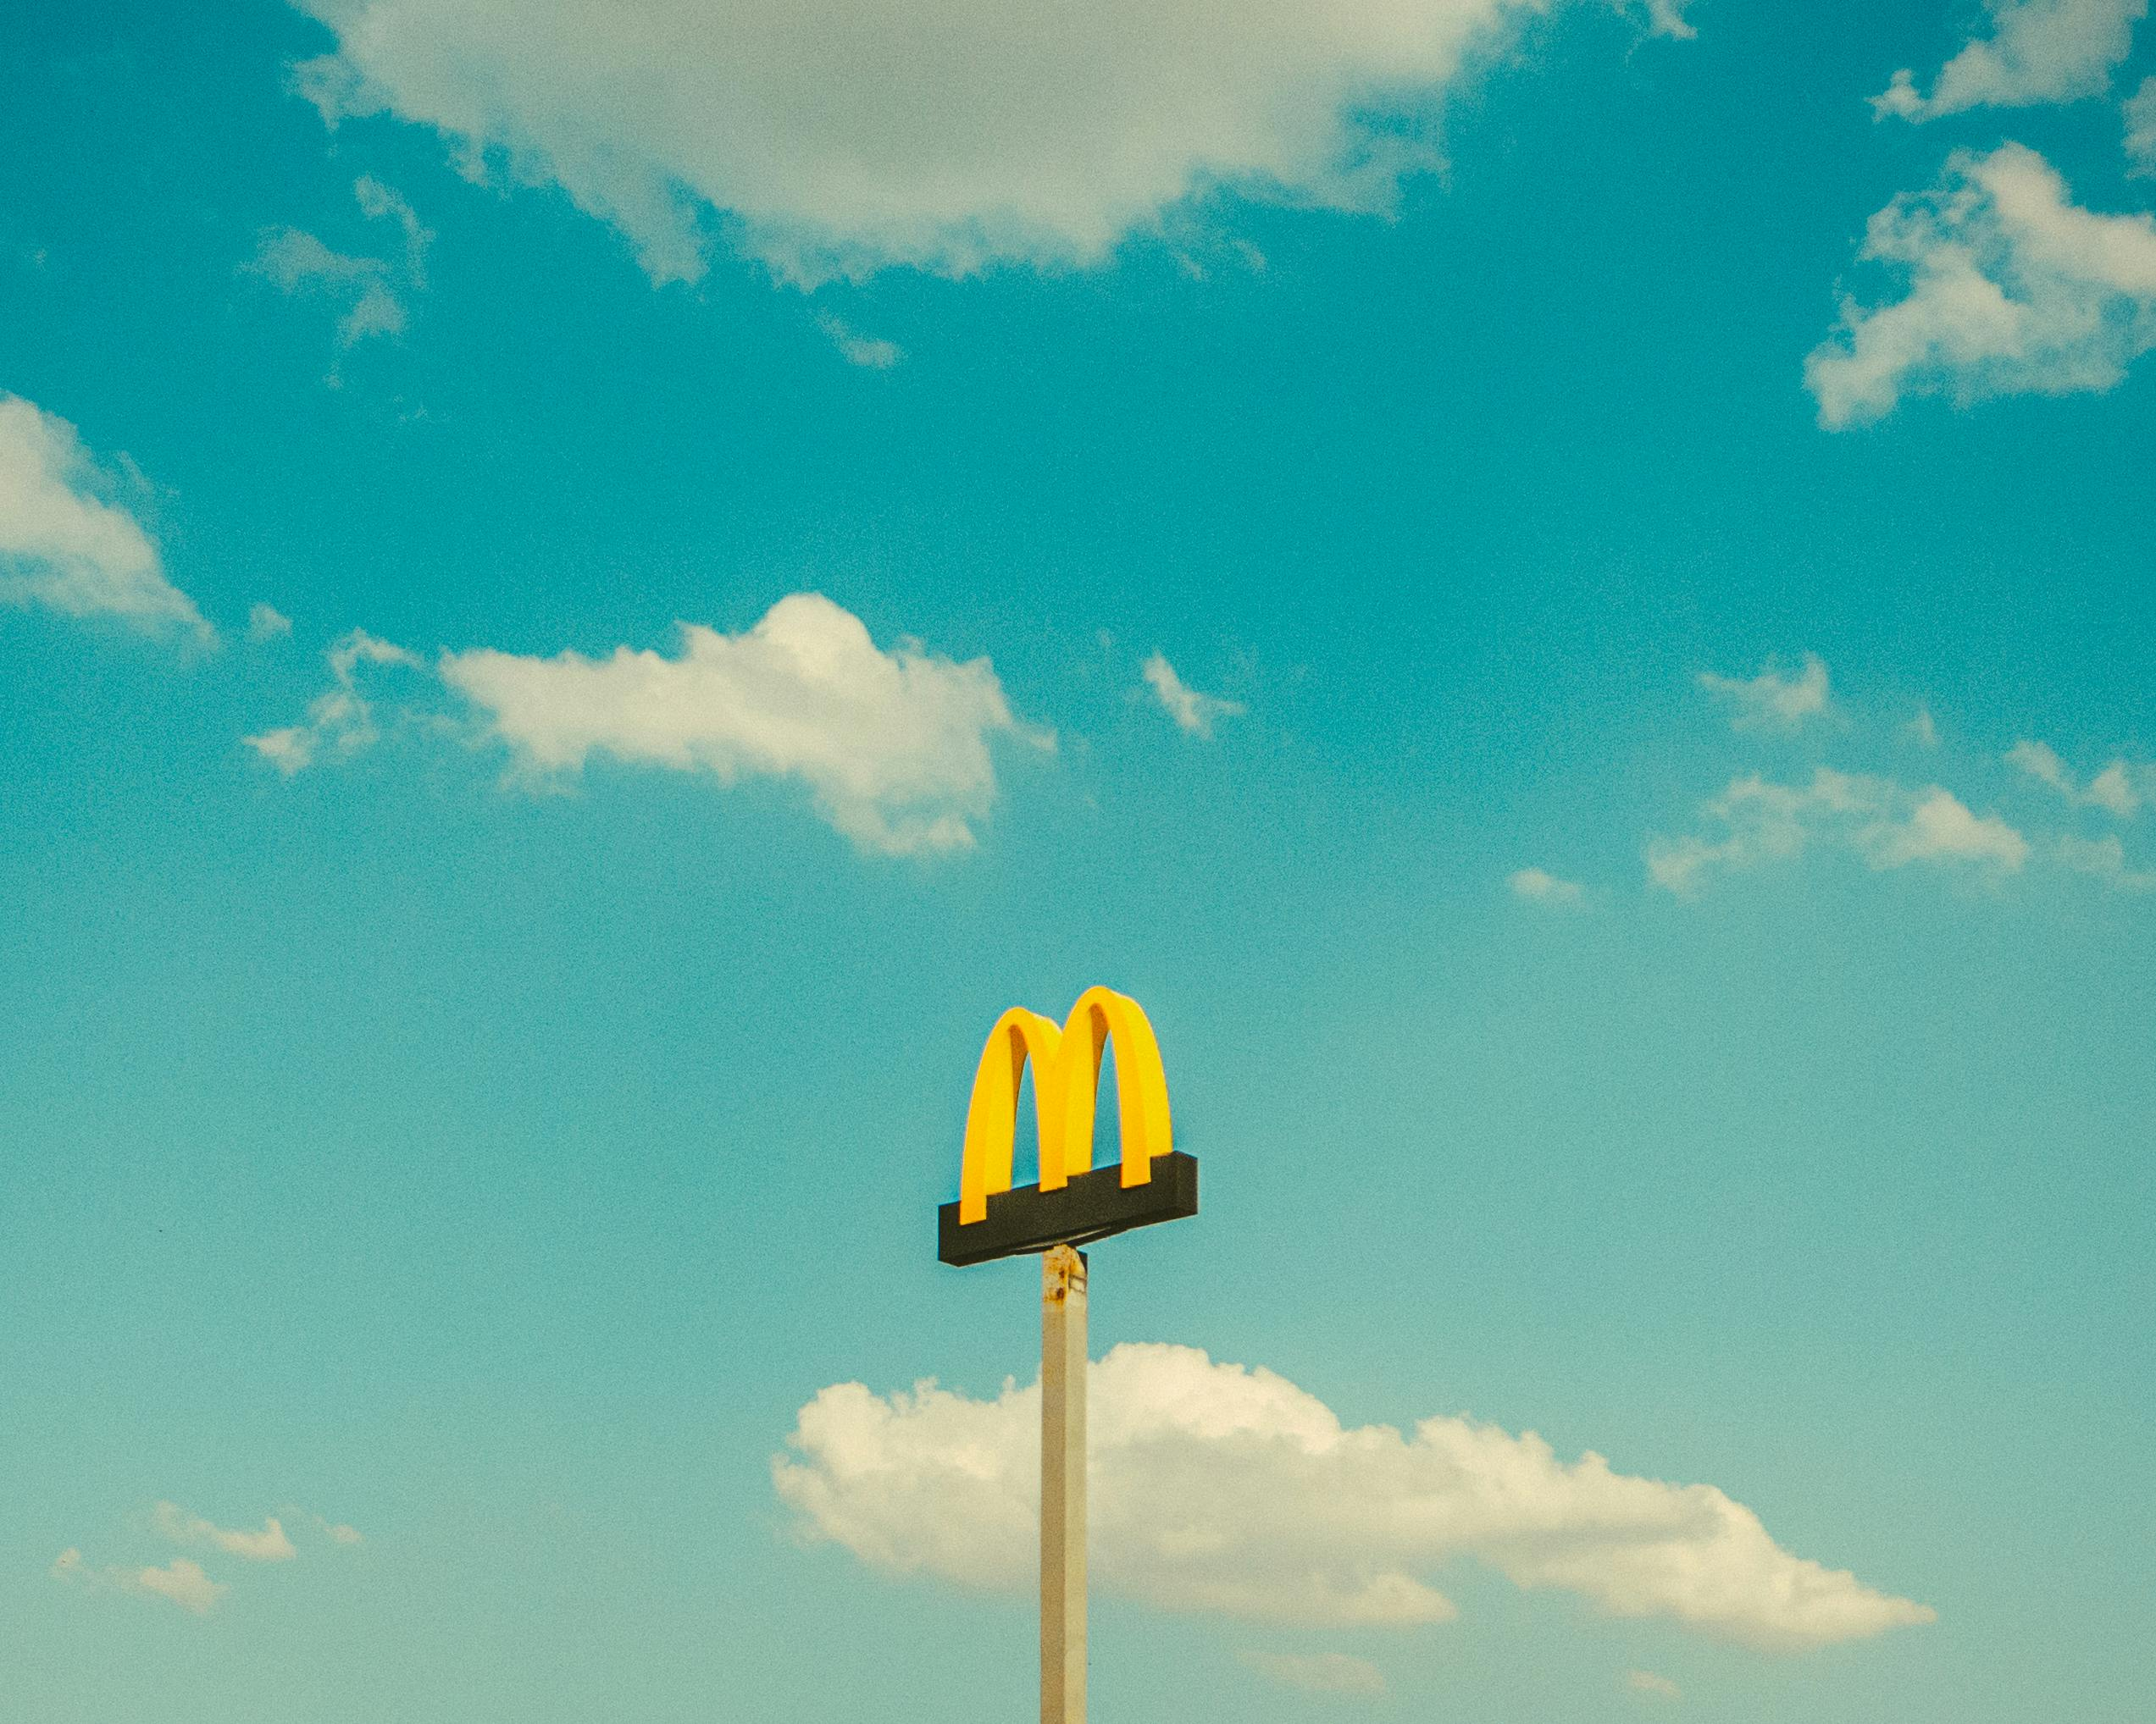
OUR VALUES
Serve
We put our customers and
people first
​Inclusion
We open our doors
to everyone
Integrity
We do the right
thing
Community
We are good
neighbors
Family
We get better
together

Slide 4
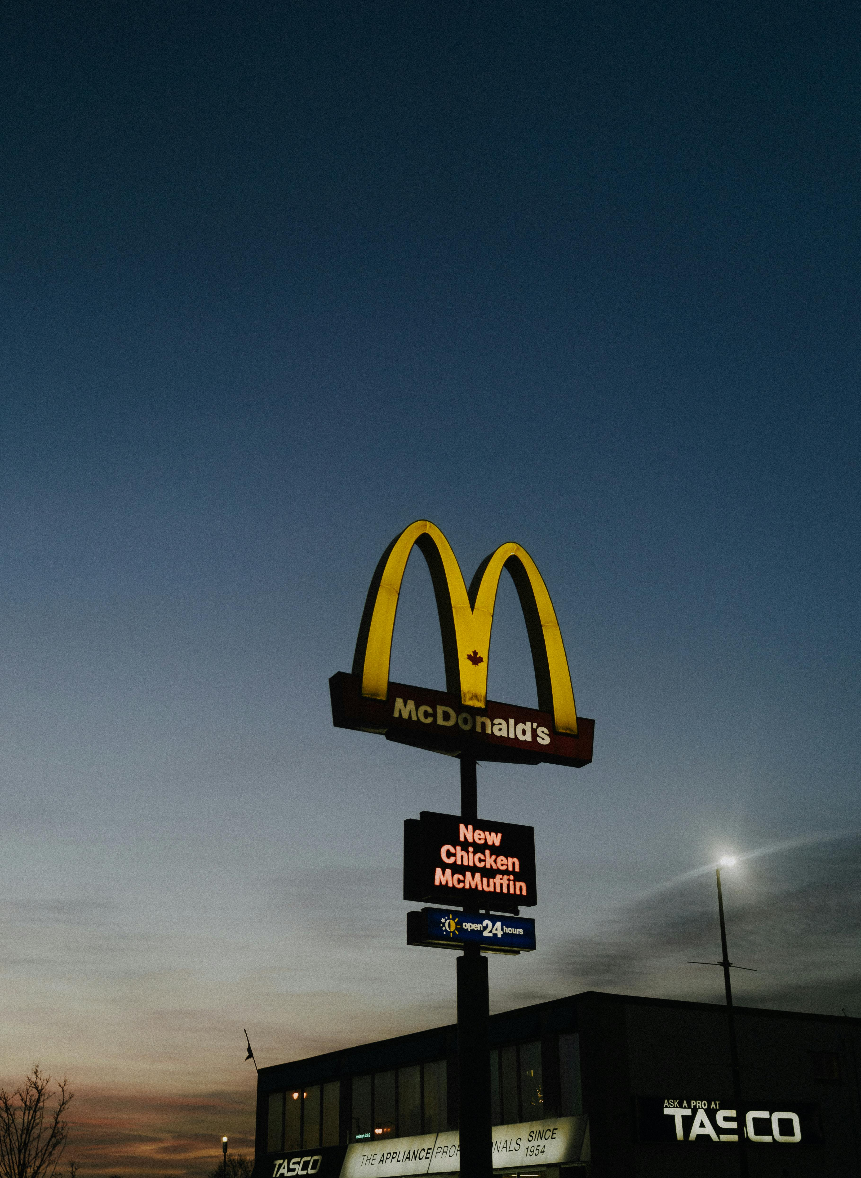




Services
Takeout
Dine-in
Delivery
Drive Thru

Slide 5
Services
Takeout
Dine-in
Delivery
Drive Thru

Slide 6
Market Price & Market Cap over the Years

Slide 7
McDonald’s Revenue Breakdown
SEGMENTS | REVENUE % (FY’23)
U.S. Market 1. | 41 %
International Operated Markets (IOM) 2. | 49 %
International Developmental Licensees & Corporate (IDL) 3. | 10 %
McDonald’s largest market in terms of Systemwide sales
+19 markets or countries including Australia, Canada, France, Germany and the U.K.
+75 markets or countries including Brazil, China and Japan

Slide 8
Industry overview

Slide 9
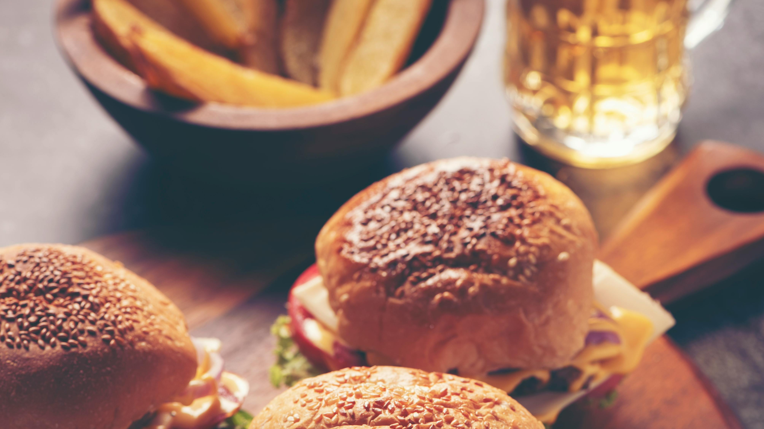
Shivani Saxena 206-555-0146 mirjam@contoso.com www.contoso.com
Thank you

